Slide 1
`
Work from home
SURESH S
STATE BEST TEACHER AWARDEE

Slide 2
NATIONAL CAREER SERVICE
श्रम एवं रोजगार मंत्रालय
Government of India Ministry of Labour & Employment

Slide 3
National Career Service
NCS Portal (www.ncs.gov.in)]
All Job Opportunities-One platform
Active Job Seekers 01,03,31,553
Active Employers 56,266
Active Vacancies 1,49,969

Slide 4

The stakeholders involved in the National Service Career Portal are:
Job Seekers
Employers
Counselors
Career Centers
Skill Providers
Placements Companies
Government Organisations

Slide 5
Access the Application
Signup/Registration
NCS Portal login
View/Edit Jobseeker Profile
Search Jobs
Jobs Applied
My Interview
Job Preferences
Feedback on Local Services

Slide 6
National Career Service New Registration
Any Jobseeker can register itself on NCS Portal
Visit https://www.ncs.gov.in/layouts/15/NCSP/Registration.aspx
The Home Page will be displayed
Click on New User? Sign Up button on the right side of the Home Page, National Career Service Portal New Registration.
Select the Jobseeker option from the “Register As” drop-down.
Fill the complete Registration Form basic details along with Unique Identification Number (either of Pan card, Voter’s Identity Card, Passport, Driving License, or UAN Number)

Slide 7
After successful registration, an OTP will be sent to the registered mobile number. Use the same OTP for successful verification.
After entering the OTP, click on Submit button and the account will be created successfully
NCS offers two kinds of profiles for Jobseekers:
Detailed Profile: For Jobseekers with qualification above class 12th
Short Profile: For Jobseekers with qualification below class 12th.

Slide 8
NCS View and Update Jobseeker Profile
Once registered on the National Career Service Portal India, the Jobseeker should update profile to get Job recommendations and noticed by Employers for relevant openings.
Click on “View/Update NCS Profile” in the left navigation panel and update profile
Detailed Profile – Personal information, Physical Attributes, Communication, Education and Training, Experience, Other Skills, My references, Preferences all the tabs need to be updated
Short Profile – Only needs to update Personal Information and Communication Tabs

Slide 9
DIGI LOCKER
Upload relevant documents under each tab using “DigiLocker connect” Link. Job seekers who are already registered on DigiLocker can sign in using existing credentials and those who do not have Did Once successfully registered on DigiLocker, NCS will take consent to share certificates with NCS registered Employers. Once consent is granted, NCS and DigiLocker accounts get connected. “DigiLocker connect” link will now change to “Upload link labels.” Upload all required documents like CV, Caste certificate, Unique Identification Id, Differently Abled certificate, Passing Certificates and Final mark sheets under relevant tabs.
Once the documents are uploaded, Jobseeker can update/delete them anytime dgiLocker account can sign up using mobile no. or Aadhaar no.

Slide 10
NCS Download Resume
Jobseekers can download a standard CV by selecting View and download CV on the Left Navigation Panel. The CV would be system generated as per the details updated by the jobseeker in View/Update NCS Profile.
Search and Apply for jobs
Once the profile is updated, Jobseeker can search for jobs by clicking on Search Jobs tab in the left navigation panel of the job seeker dashboard
search can be customized by using specific keywords, Location, Expected Salary, etc. or using advanced search parameters to further narrow down the results
After setting the search criteria, click the Search button to view search results in the Jobs section of the screen

Slide 11
Jobseeker can also save his search criteria to get job notification emails on his registered email id.
The search results can also be refined using the filters in the right navigation of the search page The job search results displays two types of jobs as follows:
Direct Job Postings on NCS – Jobs posted on the NCS portal
Job Postings by NCS Partners – Jobs posted on the NCS portal by partners
Click the “Apply” button on right side of each job posting to apply for that particular job role
For NCS partner jobs, jobseeker would be redirected to the partner’s website to finish the application process

Slide 12
NCS Scheduled Interview
If an employer has selected the job seeker for an interview the same can be viewed by the jobseeker
Job seekers can view all of his/her scheduled interviews with various employers in My Interviews tab section in the Left Panel of the job seeker dashboard
Jobseekers have the option to accept the interview invite or reject the same requesting for a change in slot

Slide 13
National Career Service Contact Number
National Career Service Centre for Differently Abled, Himachal Pradesh: 1800 425 1514
National Career Service, New Delhi: 011 2237 2704
National Institute for Career Service (NICS), Ministry of Labour & Employment, UP: 0120 240 5623

Slide 14
`
Work from home

Slide 15
Finance and Insurance
Other Service Activities
Agriculture and Related
Health
Manufacturing
Wholesale and Retail
Information Technology
Marketing & Sales
Human Resources
Finance,Insurance and Accounting Services
Customer Care Service
Education
Healthcare
Retail
Administration/Back Office Activities
Livestock, Agriculture and Farm Production

Slide 16
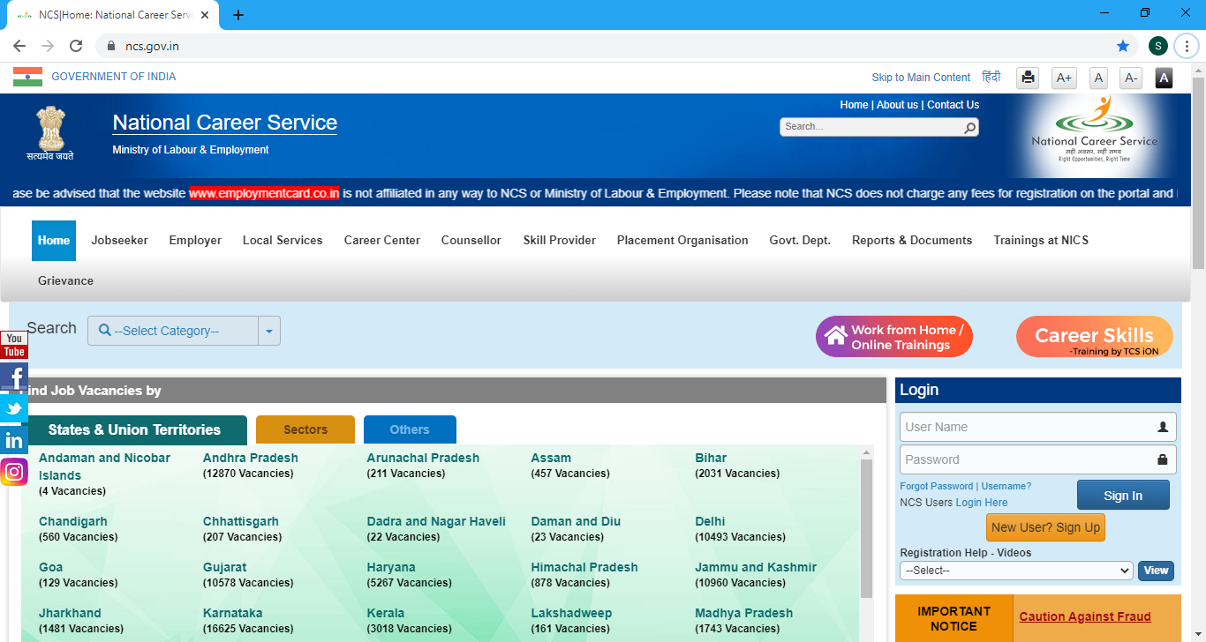

Slide 17
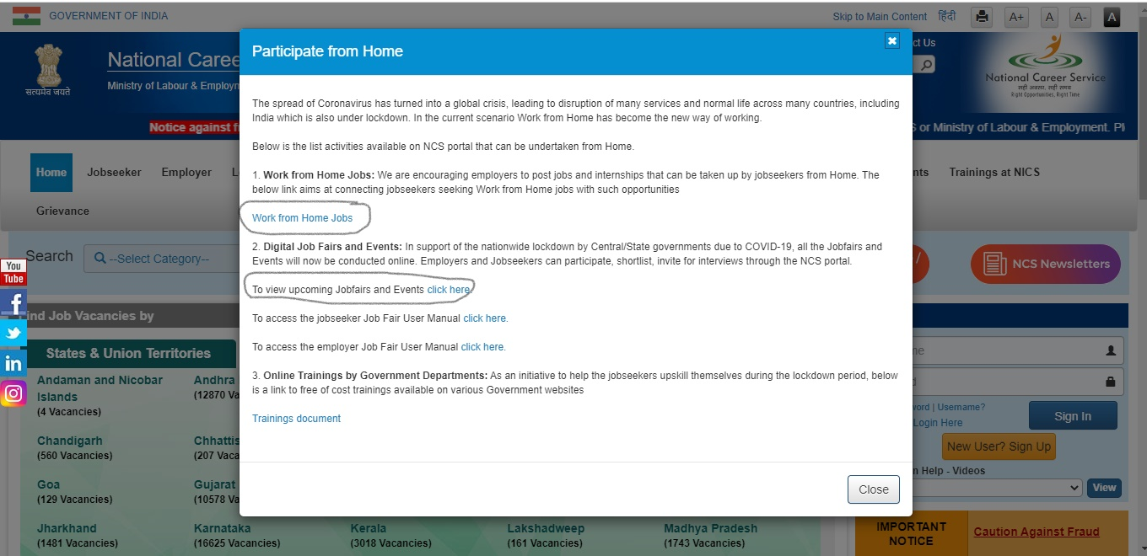

Slide 18
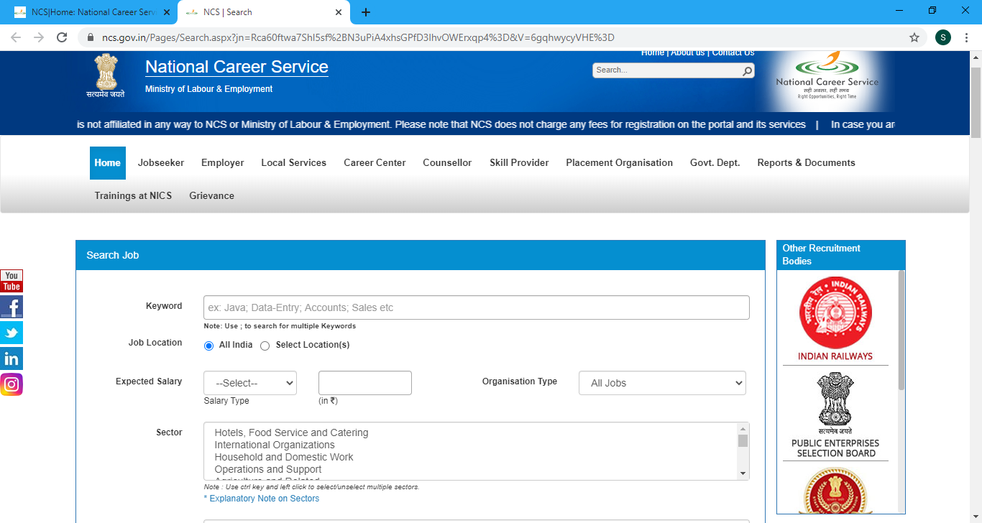

Slide 19
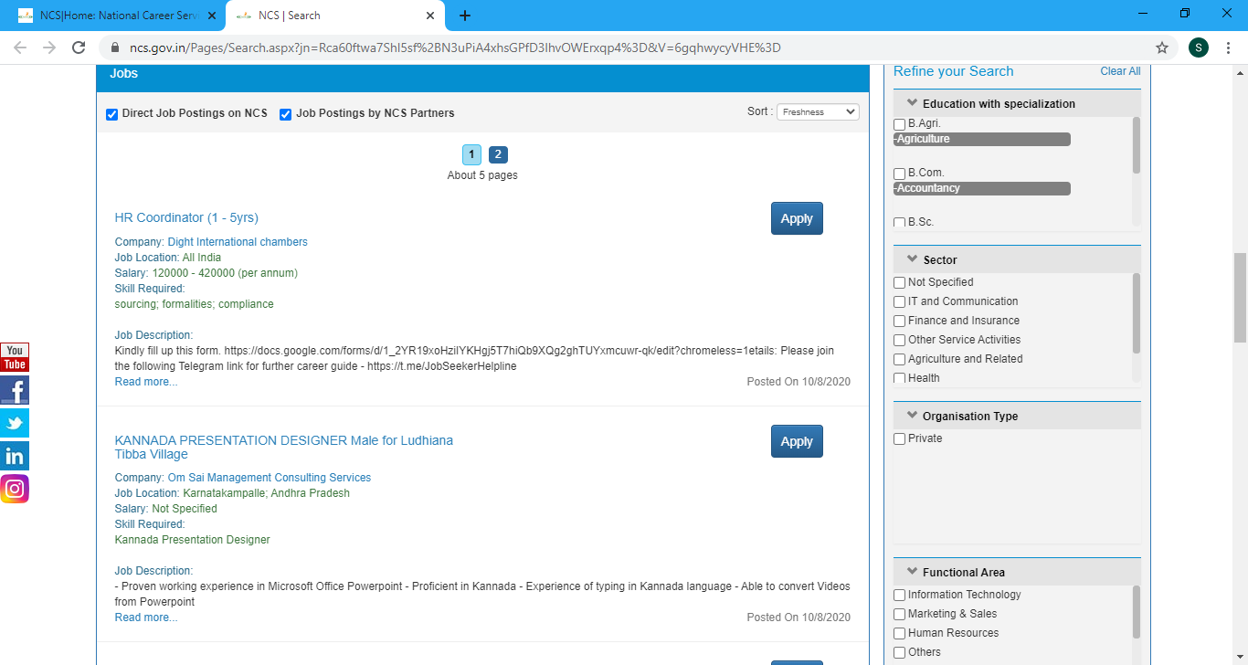

Slide 20
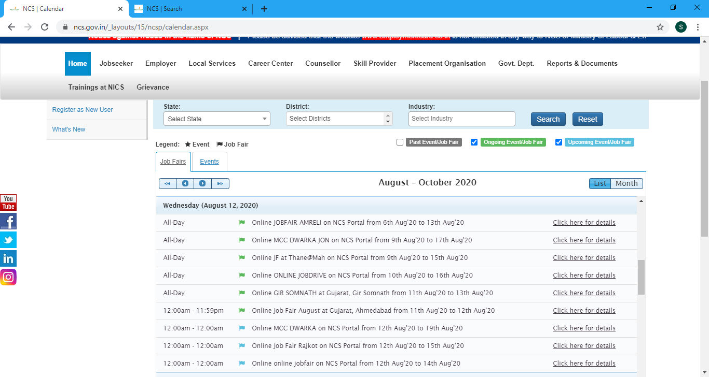

Slide 21
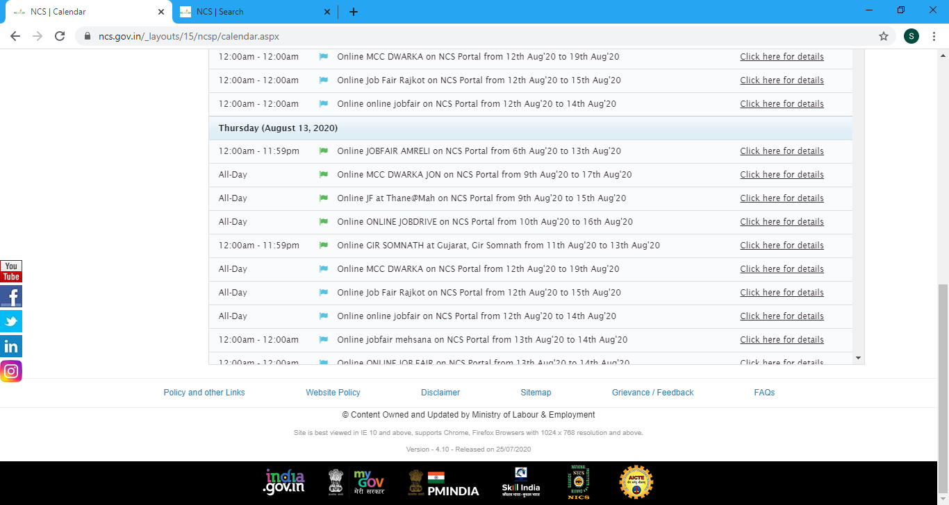

Slide 22
Thank you

